Slide 1
Introduction to Program Design & Problem-Solving Techniques, Programs, and Java

Slide 2
Objectives
To review Program Design & Problem-Solving Techniques.
To explore the relationship between Java and the World Wide Web (§1.5).
To distinguish the terms API, IDE, and JDK (§1.6).
To write a simple Java program (§1.7).
To display output on the console (§1.7).
To explain the basic syntax of a Java program (§1.7).
To create, compile, and run Java programs (§1.8).
(GUI) To display output using the JOptionPane output dialog boxes (§1.9).

Slide 3
Program Design & Problem-Solving Techniques

Slide 4
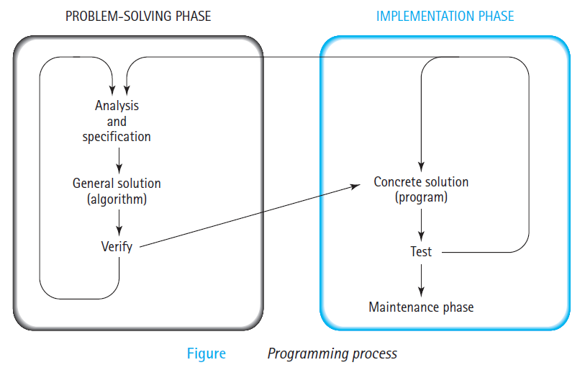
How Do We Write a Program?
A Computer is not intelligent.
It cannot analyze a problem and come up with a solution.
A human (the programmer) must analyze the problem, develop the instructions for solving the problem, and then have the computer carry out the instructions.
To write a program for a computer to follow, we must go through a two-phase process: problem solving and implementation.

Slide 5
Problem-Solving Phase
Analysis and Specification- Understand (define) the problem and what the solution must do.
General Solution (Algorithm)- Specify the required data types and the logical sequences of steps that solve the problem.
Verify- Follow the steps exactly to see if the solution really does solve the problem.

Slide 6
Implementation Phase
Concrete Solution (Program)- Translate the algorithm (the general solution) into a programming language.
Test- Have the computer follow the instructions.
Then manually check the results.
If you find errors, analyze the program and the algorithm to determine the source of the errors, and then make corrections.
Once a program is tested, it enters into next phase (maintenance).
Maintenance requires Modification of the program to meet changing requirements or to correct any errors that show up while using it.

Slide 7
Steps in
program development

Slide 8
Steps in Program Development
Define the problem into three separate components:
inputs
outputs
processing steps to produce required outputs.

Slide 9
Steps in Program Development
Outline the solution.
Decompose the problem to smaller steps.
Establish a solution outline.
Develop the outline into an algorithm.
The solution outline is now expanded into an algorithm.

Slide 10
Steps in Program Development
Test the algorithm for correctness.
Very important in the development of a program, but often forgotten
Major logic errors can be detected and corrected at an early stage.
Code the algorithm into a specific programming language.

Slide 11
Steps in Program Development
Run the program on the computer.
This step uses a program compiler and programmer-designed test data to machine-test the code for
syntax errors
logic errors
Document and maintain the program.

Slide 12
Algorithms & Flowcharts

Slide 13
What is an algorithm?
Lists the steps involved in accomplishing a task (like a recipe)
An algorithm must:
Be lucid (clear), precise and unambiguous
Give the correct solution in all cases
Eventually end
What is pseudocode?
Structured English (formalized and abbreviated to look like high-level computer language)

Slide 14
Pseudocode & Algorithm
Example 1: Write an algorithm to determine a student’s final grade and indicate whether it is passing or failing. The final grade is calculated as the average of four marks.

Slide 15
Pseudocode & Algorithm
Pseudocode:
Input a set of 4 marks
Calculate their average by summing and dividing by 4
if average is below 50
Print “FAIL”
else
Print “PASS”

Slide 16
Pseudocode & Algorithm
Detailed Algorithm
Step 1: Input M1,M2,M3,M4
Step 2: GRADE ← (M1+M2+M3+M4)/4
Step 3: if (GRADE < 50) then
Print “FAIL”
else
Print “PASS”
endif

Slide 17
Flowchart
A graphical representation of the sequence of operations in an information system or program.
Program flowcharts show the sequence of instructions in a single program or subroutine.
shows logic of an algorithm
emphasizes individual steps and their interconnections
e.g. control flow from one action to the next
Note: Different symbols are used to draw each type of flowchart.

Slide 18
Flowchart Symbols
Name
Symbol
Use in Flowchart
Oval
Denotes the beginning or end of the program
Parallelogram
Denotes an input operation
Rectangle
Denotes a process to be carried out
e
.
g
.
addition
,
subtraction
,
division etc
.
Diamond
Denotes a decision
(
or branch
)
to be made
.
The program should continue along one of
two routes
. (
e
.
g
.
IF
/
THEN
/
ELSE
)
Hybrid
Denotes an output operation
Flow line
Denotes the direction of logic flow in the program

Slide 19
Example 1
Write an algorithm and draw a flowchart to convert the length in feet to centimeter.
Pseudocode:
Input the length in feet (Lft)
Calculate the length in cm (Lcm) by multiplying LFT with 30
Print length in cm (LCM)

Slide 20
Example 1
Flowchart
Algorithm
Step 1: Input Lft
Step 2: Lcm ← Lft x 30
Step 3: Print Lcm
START
Input
Lft
Lcm ← Lft x 30
Print
Lcm
STOP

Slide 21
Example 2
Write an algorithm and draw a flowchart that will read the two sides of a rectangle and calculate its area.
Pseudocode
Input the width (W) and Length (L) of a rectangle
Calculate the area (A) by multiplying L with W
Print A

Slide 22
Example 2
Algorithm
Step 1: Input W,L
Step 2: A ← L x W
Step 3: Print A
START
Input
W, L
A ← L x W
Print
A
STOP

Slide 23
Example 3
Write an algorithm and draw a flowchart that will calculate the roots of a quadratic equation
Hint: d = sqrt ( ), and the roots are: x1 = (–b + d)/2a and x2 = (–b – d)/2a

Slide 24
Example 3
Pseudocode:
Input the coefficients (a, b, c) of the quadratic equation
Calculate d
Calculate x1
Calculate x2
Print x1 and x2

Slide 25
Example 3
START
Input
a, b, c
Algorithm:
Step 1: Input a, b, c
Step 2: d ← sqrt ( )
Step 3: x1 ← (–b + d) / (2 x a)
Step 4: x2 ← (–b – d) / (2 x a)
Step 5: Print x1, x2
d ← sqrt(b x b – 4 x a x c)
x₁ ←(–b + d) / (2 x a)
X₂ ← (–b – d) / (2 x a)
Print
x₁ ,x₂
STOP

Slide 26
Decision Structures
The expression A>B is a logical expression
it describes a condition we want to test
if A>B is true (if A is greater than B) we take the action on left
print the value of A
if A>B is false (if A is not greater than B) we take the action on right
print the value of B

Slide 27
Decision Structures
is
A>B
Y
N
Print A
Print B

Slide 28
IF–THEN–ELSE STRUCTURE
The structure is as follows
If condition then
true alternative
else
false alternative
End if

Slide 29
IF–THEN–ELSE STRUCTURE
The algorithm for the flowchart is as follows:
If A>B then
print A
else
print B
endif
is
A>B
Y
N
Print A
Print B

Slide 30
Relational Operators
Relational Operators
Operator | Description
> | Greater than
< | Less than
= | Equal to
≥ | Greater than or equal to
≤ | Less than or equal to
≠ | Not equal to

Slide 31
Example 4
Write an algorithm that reads two values, determines the largest value and prints the largest value with an identifying message.
ALGORITHM
Step 1: Input VALUE1, VALUE2
Step 2: if (VALUE1 > VALUE2) then
MAX ← VALUE1
else
MAX ← VALUE2
endif
Step 3: Print “The largest value is”, MAX

Slide 32
Example 4
START
Input
VALUE1,VALUE2
Y
is
VALUE1>VALUE2
N
MAX ← VALUE1
MAX ← VALUE2
Print
“The largest value is”, MAX
STOP

Slide 33
Programming Languages
Machine Language Assembly Language High-Level Language
Machine language is a set of primitive instructions built into every computer. The instructions are in the form of binary code, so you have to enter binary codes for various instructions. Program with native machine language is a tedious process. Moreover the programs are highly difficult to read and modify. For example, to add two numbers, you might write an instruction in binary like this:
1101101010011010

Slide 34
Programming Languages
Machine Language Assembly Language High-Level Language
Assembly languages were developed to make programming easy. Since the computer cannot understand assembly language, however, a program called assembler is used to convert assembly language programs into machine code. For example, to add two numbers, you might write an instruction in assembly code like this:
ADDF3 R1, R2, R3

Slide 35
Programming Languages
Machine Language Assembly Language High-Level Language
The high-level languages are English-like and easy to learn and program. For example, the following is a high-level language statement that computes the area of a circle with radius 5:
area = 5 * 5 * 3.1415;

Slide 36
Popular High-Level Languages
COBOL (COmmon Business Oriented Language)
FORTRAN (FORmula TRANslation)
BASIC (Beginner All-purpose Symbolic Instructional Code)
Pascal (named for Blaise Pascal)
Ada (named for Ada Lovelace)
C (whose developer designed B first)
Visual Basic (Basic-like visual language developed by Microsoft)
Delphi (Pascal-like visual language developed by Borland)
C++ (an object-oriented language, based on C)
C# (a Java-like language developed by Microsoft)
Java (We use it in the book)

Slide 37
Compiling Source Code
A program written in a high-level language is called a source program. Since a computer cannot understand a source program. Program called a compiler is used to translate the source program into a machine language program called an object program. The object program is often then linked with other supporting library code before the object can be executed on the machine.

Slide 38
Why Java?
The answer is that Java enables users to develop and deploy applications on the Internet for servers, desktop computers, and small hand-held devices. The future of computing is being profoundly influenced by the Internet, and Java promises to remain a big part of that future. Java is the Internet programming language.
Java is a general purpose programming language.
Java is the Internet programming language.

Slide 39
Java, Web, and Beyond
Java can be used to develop Web applications.
Java Applets
Java Web Applications
Java can also be used to develop applications for hand-held devices such as Palm and cell phones

Slide 40
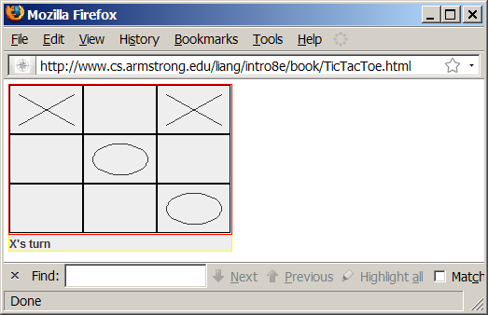
Examples of Java’s Versatility (Applets)

Slide 41
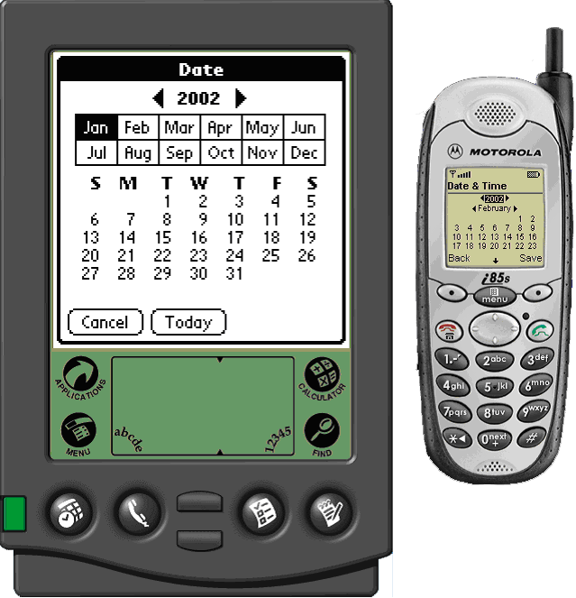
PDA and Cell Phone

Slide 42
Java’s History
James Gosling and Sun Microsystems
Oak
Java, May 20, 1995, Sun World
HotJava
The first Java-enabled Web browser
Early History Website:
http://java.sun.com/features/1998/05/birthday.html

Slide 43
Characteristics of Java
Companion Website
Java Is Simple
Java Is Object-Oriented
Java Is Distributed
Java Is Interpreted
Java Is Robust
Java Is Secure
Java Is Architecture-Neutral
Java Is Portable
Java's Performance
Java Is Multithreaded
Java Is Dynamic
www.cs.armstrong.edu/liang/intro8e/JavaCharacteristics.pdf

Slide 44
Characteristics of Java
Companion Website
Java Is Simple
Java Is Object-Oriented
Java Is Distributed
Java Is Interpreted
Java Is Robust
Java Is Secure
Java Is Architecture-Neutral
Java Is Portable
Java's Performance
Java Is Multithreaded
Java Is Dynamic
Java is partially modeled on C++, but greatly simplified and improved. Some people refer to Java as "C++--" because it is like C++ but with more functionality and fewer negative aspects.

Slide 45
Characteristics of Java
Companion Website
Java Is Simple
Java Is Object-Oriented
Java Is Distributed
Java Is Interpreted
Java Is Robust
Java Is Secure
Java Is Architecture-Neutral
Java Is Portable
Java's Performance
Java Is Multithreaded
Java Is Dynamic
Java is inherently object-oriented. Although many object-oriented languages began strictly as procedural languages, Java was designed from the start to be object-oriented. Object-oriented programming (OOP) is a popular programming approach that is replacing traditional procedural programming techniques.
One of the central issues in software development is how to reuse code. Object-oriented programming provides great flexibility, modularity, clarity, and reusability through encapsulation, inheritance, and polymorphism.

Slide 46
Characteristics of Java
Companion Website
Java Is Simple
Java Is Object-Oriented
Java Is Distributed
Java Is Interpreted
Java Is Robust
Java Is Secure
Java Is Architecture-Neutral
Java Is Portable
Java's Performance
Java Is Multithreaded
Java Is Dynamic
Distributed computing involves several computers working together on a network. Java is designed to make distributed computing easy. Since networking capability is inherently integrated into Java, writing network programs is like sending and receiving data to and from a file.

Slide 47
Characteristics of Java
Companion Website
Java Is Simple
Java Is Object-Oriented
Java Is Distributed
Java Is Interpreted
Java Is Robust
Java Is Secure
Java Is Architecture-Neutral
Java Is Portable
Java's Performance
Java Is Multithreaded
Java Is Dynamic
You need an interpreter to run Java programs. The programs are compiled into the Java Virtual Machine code called bytecode. The bytecode is machine-independent and can run on any machine that has a Java interpreter, which is part of the Java Virtual Machine (JVM).

Slide 48
Characteristics of Java
Companion Website
Java Is Simple
Java Is Object-Oriented
Java Is Distributed
Java Is Interpreted
Java Is Robust
Java Is Secure
Java Is Architecture-Neutral
Java Is Portable
Java's Performance
Java Is Multithreaded
Java Is Dynamic
Java compilers can detect many problems that would first show up at execution time in other languages.
Java has eliminated certain types of error-prone programming constructs found in other languages.
Java has a runtime exception-handling feature to provide programming support for robustness.

Slide 49
Characteristics of Java
Companion Website
Java Is Simple
Java Is Object-Oriented
Java Is Distributed
Java Is Interpreted
Java Is Robust
Java Is Secure
Java Is Architecture-Neutral
Java Is Portable
Java's Performance
Java Is Multithreaded
Java Is Dynamic
Java implements several security mechanisms to protect your system against harm caused by stray programs.

Slide 50
Characteristics of Java
Companion Website
Java Is Simple
Java Is Object-Oriented
Java Is Distributed
Java Is Interpreted
Java Is Robust
Java Is Secure
Java Is Architecture-Neutral
Java Is Portable
Java's Performance
Java Is Multithreaded
Java Is Dynamic
Write once, run anywhere
With a Java Virtual Machine (JVM), you can write one program that will run on any platform.

Slide 51
Characteristics of Java
Companion Website
Java Is Simple
Java Is Object-Oriented
Java Is Distributed
Java Is Interpreted
Java Is Robust
Java Is Secure
Java Is Architecture-Neutral
Java Is Portable
Java's Performance
Java Is Multithreaded
Java Is Dynamic
Because Java is architecture neutral, Java programs are portable. They can be run on any platform without being recompiled.

Slide 52
Characteristics of Java
Companion Website
Java Is Simple
Java Is Object-Oriented
Java Is Distributed
Java Is Interpreted
Java Is Robust
Java Is Secure
Java Is Architecture-Neutral
Java Is Portable
Java's Performance
Java Is Multithreaded
Java Is Dynamic
Java’s performance Because Java is architecture neutral, Java programs are portable. They can be run on any platform without being recompiled.

Slide 53
Characteristics of Java
Companion Website
Java Is Simple
Java Is Object-Oriented
Java Is Distributed
Java Is Interpreted
Java Is Robust
Java Is Secure
Java Is Architecture-Neutral
Java Is Portable
Java's Performance
Java Is Multithreaded
Java Is Dynamic
Multithread programming is smoothly integrated in Java, whereas in other languages you have to call procedures specific to the operating system to enable multithreading.

Slide 54
Characteristics of Java
Companion Website
Java Is Simple
Java Is Object-Oriented
Java Is Distributed
Java Is Interpreted
Java Is Robust
Java Is Secure
Java Is Architecture-Neutral
Java Is Portable
Java's Performance
Java Is Multithreaded
Java Is Dynamic
Java was designed to adapt to an evolving environment. New code can be loaded on the fly without recompilation. There is no need for developers to create, and for users to install, major new software versions. New features can be incorporated transparently as needed.

Slide 55
JDK Versions
JDK 1.02 (1995)
JDK 1.1 (1996)
JDK 1.2 (1998)
JDK 1.3 (2000)
JDK 1.4 (2002)
JDK 1.5 (2004) a. k. a. JDK 5 or Java 5
JDK 1.6 (2006) a. k. a. JDK 6 or Java 6
JDK 1.7 (2011) a. k. a. JDK 7 or Java 7
Java SE 8 (2014) - Still supported
Java SE 9 (2017)
Java SE 10 (March 2018)
Java SE 11 (September 2018) – Still supported
Java SE 12 (March 2019) - Latest

Slide 56
JDK Editions
Java Standard Edition (J2SE)
J2SE can be used to develop client-side standalone applications or applets.
Java Enterprise Edition (J2EE)
J2EE can be used to develop server-side applications such as Java servlets and Java ServerPages.
Java Micro Edition (J2ME).
J2ME can be used to develop applications for mobile devices such as cell phones.
This book uses J2SE to introduce Java programming.

Slide 57
Popular Java IDEs
NetBeans Open Source
Eclipse Open Source

Slide 58
A Simple Java Program
Listing 1.1
//This program prints Welcome to Java!
public class Welcome {
public static void main(String[] args) {
System.out.println("Welcome to Java!");
}
}
Welcome
Run

Slide 59

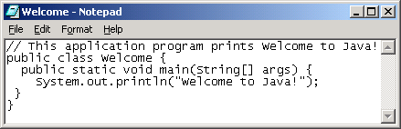
Creating and Editing Using NotePad
To use NotePad, type
notepad Welcome.java
from the DOS prompt.

Slide 60

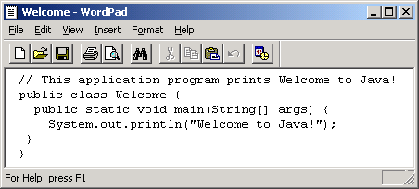
Creating and Editing Using WordPad
To use WordPad, type
write Welcome.java
from the DOS prompt.

Slide 61
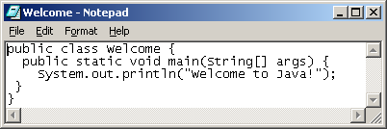
Creating, Compiling, and Running Programs

Slide 62
Compiling Java Source Code
You can port a source program to any machine with appropriate compilers. The source program must be recompiled, however, because the object program can only run on a specific machine. Nowadays computers are networked to work together. Java was designed to run object programs on any platform. With Java, you write the program once, and compile the source program into a special type of object code, known as bytecode. The bytecode can then run on any computer with a Java Virtual Machine, as shown below. Java Virtual Machine is a software that interprets Java bytecode.

Slide 63
Trace a Program Execution
animation
Enter main method
//This program prints Welcome to Java!
public class Welcome {
public static void main(String[] args) {
System.out.println("Welcome to Java!");
}
}

Slide 64
Trace a Program Execution
animation
Execute statement
//This program prints Welcome to Java!
public class Welcome {
public static void main(String[] args) {
System.out.println("Welcome to Java!");
}
}

Slide 65
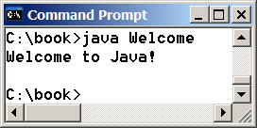
Trace a Program Execution
animation
//This program prints Welcome to Java!
public class Welcome {
public static void main(String[] args) {
System.out.println("Welcome to Java!");
}
}
print a message to the console

Slide 66
Two More Simple Examples
Welcome1
Run
ComputeExpression
Run

Slide 67
Supplements on the Companion Website
Companion Website
See Supplement I.B for installing and configuring JDK
See Supplement I.C for compiling and running Java from the command window for details
www.cs.armstrong.edu/liang/intro8e

Slide 68
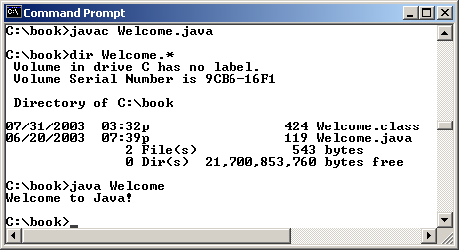
Compiling and Running Java from the Command Window
Companion Website
Set path to JDK bin directory
set path=c:\Program Files\java\jdk1.6.0\bin
Set classpath to include the current directory
set classpath=.
Compile
javac Welcome.java
Run
java Welcome

Slide 69
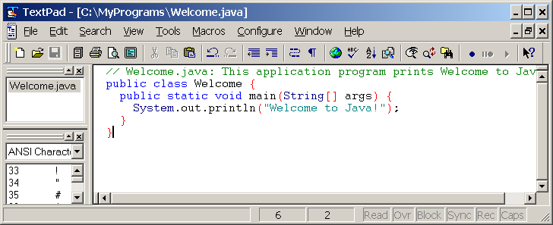
Compiling and Running Java from TextPad
Companion Website
See Supplement II.A on the Website for details

Slide 70
Compiling and Running Java from JBuilder
Companion Website
See Supplement II.H on the Website for details

Slide 71
Compiling and Running Java from NetBeans
Companion Website
See Supplement I.D on the Website for details

Slide 72
Anatomy of a Java Program
Comments
Reserved words
Modifiers
Statements
Blocks
Classes
Methods
The main method

Slide 73
Comments
Three types of comments in Java.
Line comment: A line comment is preceded by two slashes (//) in a line.
Paragraph comment: A paragraph comment is enclosed between /* and */ in one or multiple lines.
javadoc comment: javadoc comments begin with /** and end with */. They are used for documenting classes, data, and methods. They can be extracted into an HTML file using JDK's javadoc command.

Slide 74
Reserved Words
Reserved words or keywords are words that have a specific meaning to the compiler and cannot be used for other purposes in the program. For example, when the compiler sees the word class, it understands that the word after class is the name for the class. Other reserved words in Listing 1.1 are public, static, and void. Their use will be introduced later in the book.

Slide 75
Modifiers
Java uses certain reserved words called modifiers that specify the properties of the data, methods, and classes and how they can be used. Examples of modifiers are public and static. Other modifiers are private, final, abstract, and protected. A public datum, method, or class can be accessed by other programs. A private datum or method cannot be accessed by other programs. Modifiers are discussed in Chapter 6, “Objects and Classes.”

Slide 76
Statements
A statement represents an action or a sequence of actions. The statement System.out.println("Welcome to Java!") in the program in Listing 1.1 is a statement to display the greeting "Welcome to Java!" Every statement in Java ends with a semicolon (;).

Slide 77
Blocks
A pair of braces in a program forms a block that groups components of a program.

Slide 78
Classes
The class is the essential Java construct. A class is a template or blueprint for objects. To program in Java, you must understand classes and be able to write and use them. The mystery of the class will continue to be unveiled throughout this book. For now, though, understand that a program is defined by using one or more classes.

Slide 79
Methods
What is System.out.println? It is a method: a collection of statements that performs a sequence of operations to display a message on the console. It can be used even without fully understanding the details of how it works. It is used by invoking a statement with a string argument. The string argument is enclosed within parentheses. In this case, the argument is "Welcome to Java!" You can call the same println method with a different argument to print a different message.

Slide 80
main Method
The main method provides the control of program flow. The Java interpreter executes the application by invoking the main method.
The main method looks like this:
public static void main(String[] args) {
// Statements;
}

Slide 81
Displaying Text in a Message Dialog Box
you can use the showMessageDialog method in the JOptionPane class. JOptionPane is one of the many predefined classes in the Java system, which can be reused rather than “reinventing the wheel.”
WelcomeInMessageDialogBox
Run

Slide 82
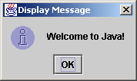
The showMessageDialog Method
JOptionPane.showMessageDialog(null,
"Welcome to Java!",
"Display Message",
JOptionPane.INFORMATION_MESSAGE);

Slide 83
Two Ways to Invoke the Method
There are several ways to use the showMessageDialog method. For the time being, all you need to know are two ways to invoke it.
One is to use a statement as shown in the example:
JOptionPane.showMessageDialog(null, x,
y, JOptionPane.INFORMATION_MESSAGE);
where x is a string for the text to be displayed, and y is a string for the title of the message dialog box.
The other is to use a statement like this:
JOptionPane.showMessageDialog(null, x);
where x is a string for the text to be displayed.

